Slide 1
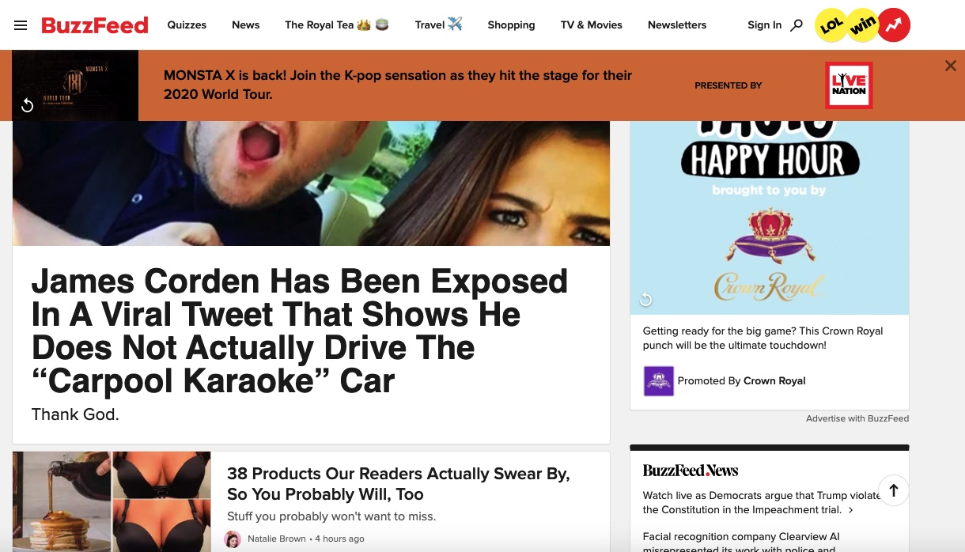
Perception/ Memory Applied Analysis Assignment #2
Alyssa Hagen
January 25, 2020
CommLead 517: The Psychology of UX

Slide 2
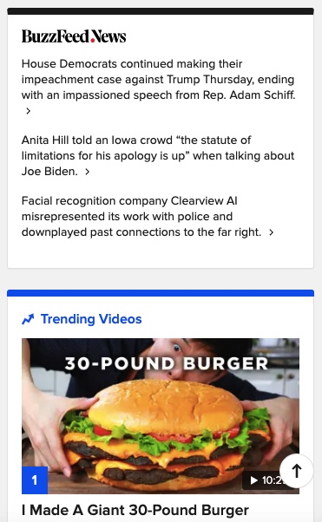
When BuzzFeed journalism content and advertisements compete for attention, user confidence drops.
BuzzFeed https://www.buzzfeed.com/, based in New York City, is an American Internet media, news and entertainment company with a focus on digital media.
BuzzFeed, founded in 2006 was initially focused on tracking viral content, but expanded the site in 2011 to include serious journalism.
The site won national awards, but a 2014 Pew Research Center survey indicated that in the United States, BuzzFeed was viewed as an unreliable source by the majority of respondents, regardless of age or political affiliation.
BuzzFeed News https://www.buzzfeednews.com/ has since moved to its own domain rather than exist as a section of the main BuzzFeed website.
The integrity of BuzzFeed news content is compromised by advertisements which appear identical to the user.
Advertisements are more attention-grabbing than articles.
Advertisements appear visually identical to BuzzFeed video content.
Advertisements are disguised as credible journalism.
Slide 1: THE PSYCH. Describe the psychological process in a way that would be understandable and persuasive to a business decision-maker (original textual summary, 12-14 point font).
Notes:
Suggest an improvement to prevent users from needing to retain information in working memory for 30+ seconds.
Suggest an improvement to prevent important information from being displaced by subsequent information.
Bottlenecks 7-10.

Slide 3
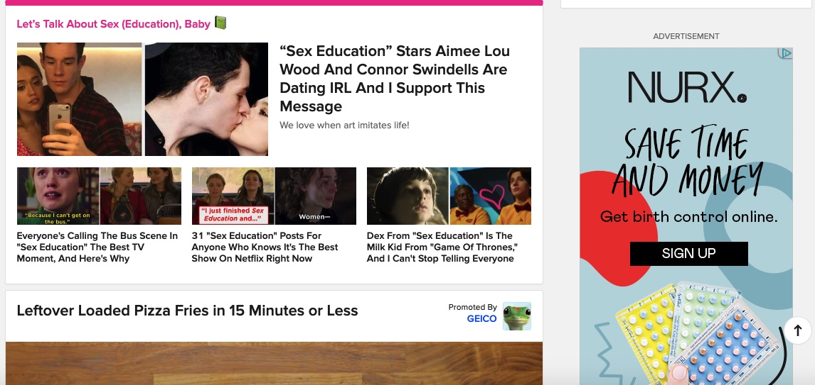
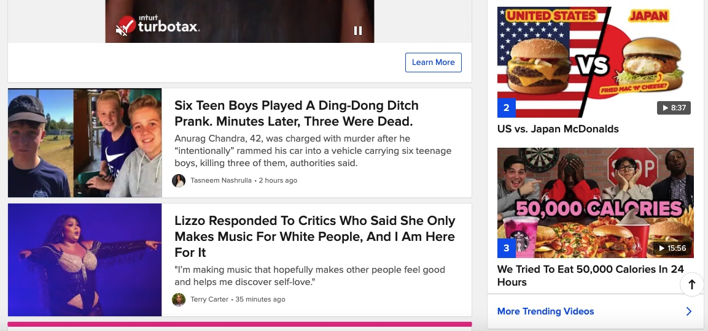
BuzzFeed user confidence & attention drops when they determine whether each item on a page is an ad, an article… or both.
You’ll never be able to spot the advertisements on this BuzzFeed webpage!
As BuzzFeed website users enter the site, they are bombarded with a large pop-up ad, which covers and moves content below. As the user scrolls, the large banner add remains, visually blocking news articles.
Simultaneously, one or two ads or videos flash to grab the users’ attention. Often, provocative photos, “challenges” and click bait articles compete for space on the page. Users must determine quickly what is an ad and what isn’t, thus requiring a constant need to rely on working memory for longer than 30-seconds.
Surprisingly, many of the videos, which appear to be straight-forward ads are in fact articles. However, the articles feature a product, so essentially, the article itself is an ad!
By confusing the user, BuzzFeed is compromising their credibility as an informational site. As a result, they will continue to lose readership and user trust, similar to the way they lost readership relating to the BuzzFeed News site.
All content on BuzzFeed is at risk of remaining unencoded, as articles and ads require so much processing, nothing is stored.
Slide 2: THE EXAMPLE. Explain how the psychological process is at play in users' experience with a digital meme (screenshots and half-page explanation).
Notes:
Suggest an improvement to prevent users from needing to retain information in working memory for 30+ seconds.
Suggest an improvement to prevent important information from being displaced by subsequent information.
Bottlenecks 7-10.

Slide 4
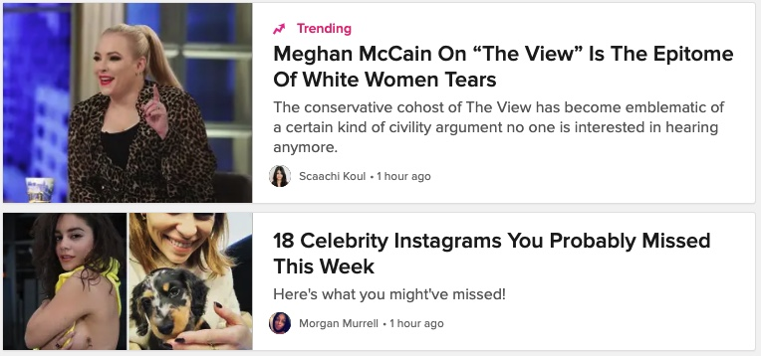
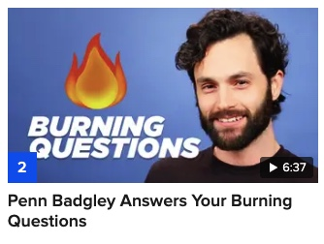
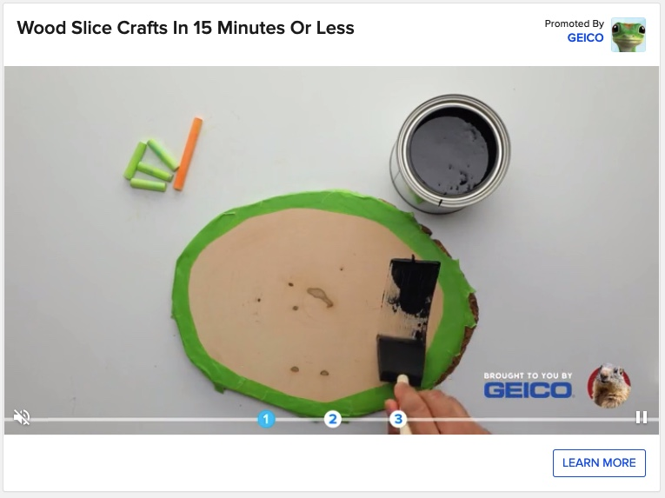
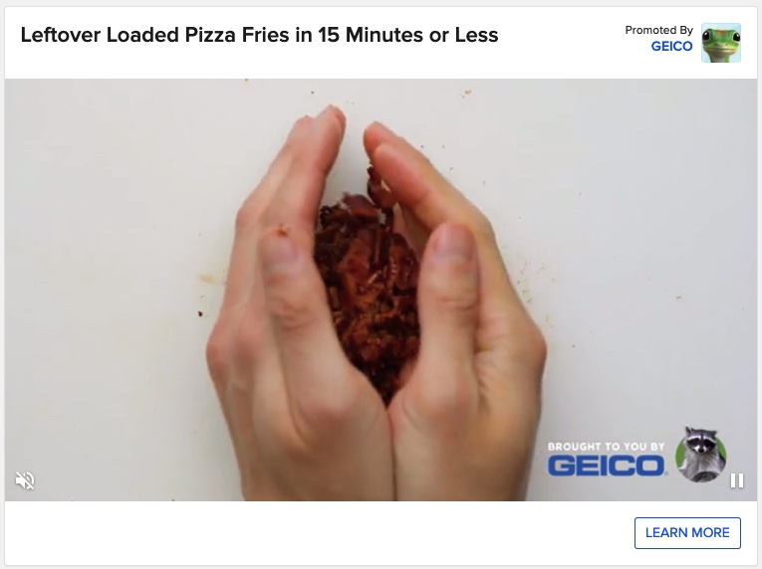
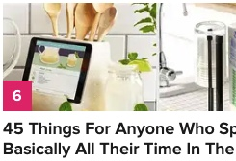
BuzzFeed should format articles and advertisements using consistent color palettes and placement.
Articles
Advertisements
News articles
Based on the “F” shape eye-tracking pattern, webpage journalistic articles should be placed along the top and left side of the page.
Videos should be grouped together; never mixed with advertisement videos.
All ads should be listed on the right side of the page, with a secondary color box to provide a visual cue that the items on the left differ from those on the right. The “Advertisements” heading should appear in a different font than the rest of the site.
To respect the existing “culture” or style BuzzFeed created, the left and right sides of the page could remain a reflection of each other, combining articles with ads.
For example, bulleted new items remain on top, videos are placed in a row below and as users scroll, variable types of content are included, but are generally reflective of a left/right split with news on the left and ads on the right.
Advertisements
Videos
Utilization of advertisement color and placement would:
Reduce memory fatigue
Retain users
Maintain user trust
Drive content consumption
Improve ad monetization
Quizzes
More fun stuff!
Slide 3: THE ETHICAL IMPROVEMENT. Recommend for changes to the digital meme would better align it with the psychology of the users (bulleted list and paragraphs).

Slide 5
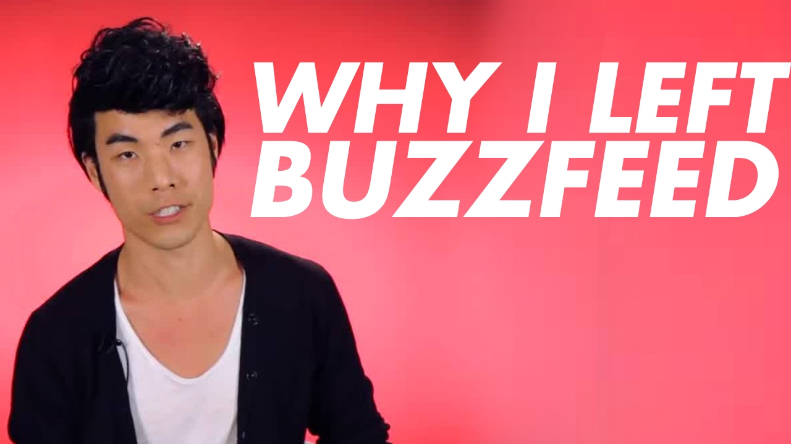
BuzzFeed’s influence expands beyond their own website.
BuzzFeed users are challenged by the constant displacement of information on the website. Rather than relying on working memory, readers must constantly reassess what are versus what are not advertisements.
Each item on the BuzzFeed site is itself a bottleneck, as it requires the users short term memory to differentiate between discovering the type of content they intend to consume.
Buzzfeed’s target audience is skewed heavily toward young women, ages 18-34. With access to digital devices, TikTok and memes, BuzzFeed’s actual audience includes anyone with a cell phone. They rely on users to share their content to other platforms.
While older, more sophisticated viewers can parse out ads versus journalism, younger users cannot. By combining ads in articles, BuzzFeed is relying on technology addiction and FOMO (fear of missing out) to get and hold young consumers’ attention. This is unethical, as it confuses the user and constantly pushes unintended content.
By failing to make two simple changes to their site, BuzzFeed creates and perpetuates a distrust in online journalism and consumption of news online.
BuzzFeed should alter their news articles to be more aware of Targeting young people
Teaching younger users to trust unreliable sources, such as those that advertise within perceived news articles.
BuzzFeed should
Delineate news articles from advertisements
Eliminate article/ ad crossover
Slide 4: AN UNETHICAL IMPROVEMENT. Recommend against changes to the digital meme that would overpower, sidestep, or exploit the psychology of the users

Slide 6
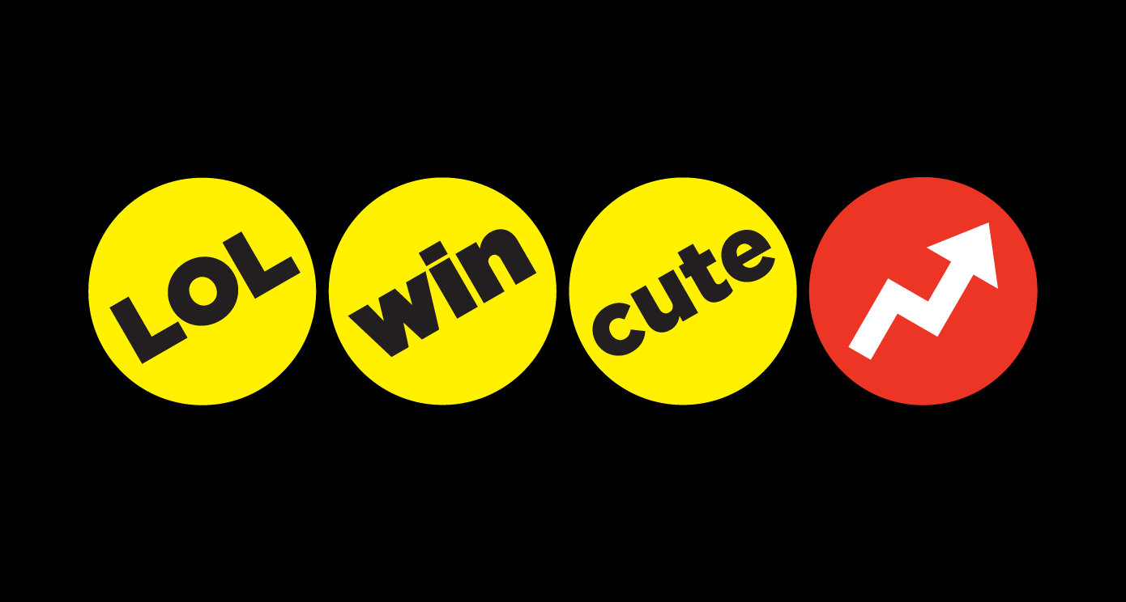
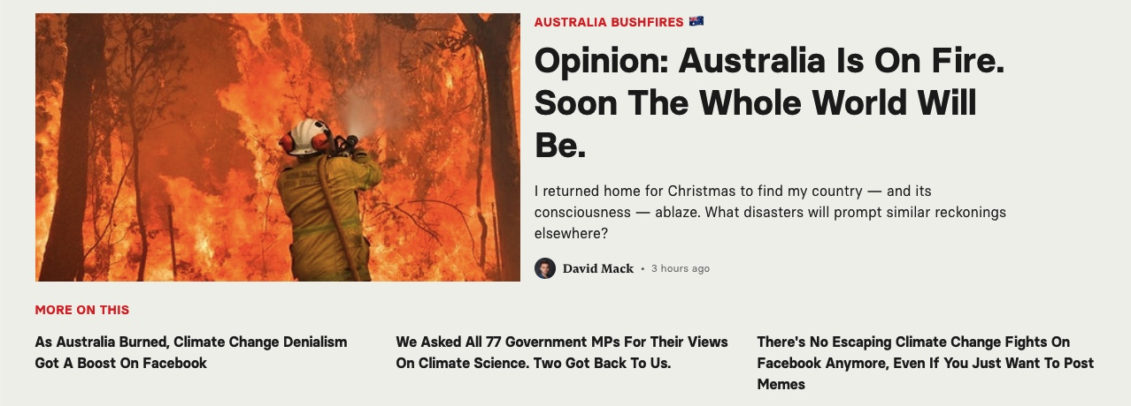
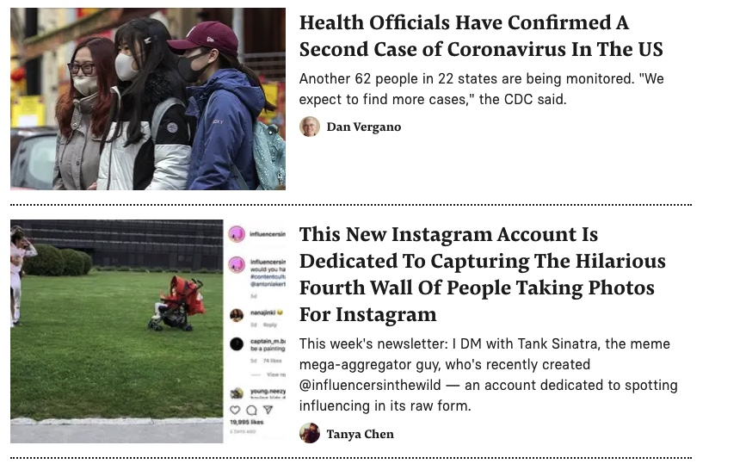
Changes to BuzzFeed User Interface will make an immediate and direct impact.
Business metrics can be tracked before and after the suggested changes are made.
Visual differentiation between ads will require less working memory and users will remain on the site for a longer duration of time.
It is possible that ad consumption and click-throughs will decline, however the site credibility will improve. As the site regains its reputation for quality content, the advertisers will continue to invest.
BuzzFeed memes will have an increased sharing, as users will feel more confident that the articles are based in fact, and not cleverly hidden ads.
Industry watchdogs will notice the changes and BuzzFeed.com may again compete for website awards.
Parents of 13-year-old girls may again consider letting their daughter read BuzzFeed and refer to it as a credible source of information.
Ad revenue
User retention
Memes shared
User satisfaction
Industry feedback
Slide 5: THE RESULT. Identify what business outcome metric (usage, satisfaction) should be measured before and after the changes are implemented.

